Slide 1
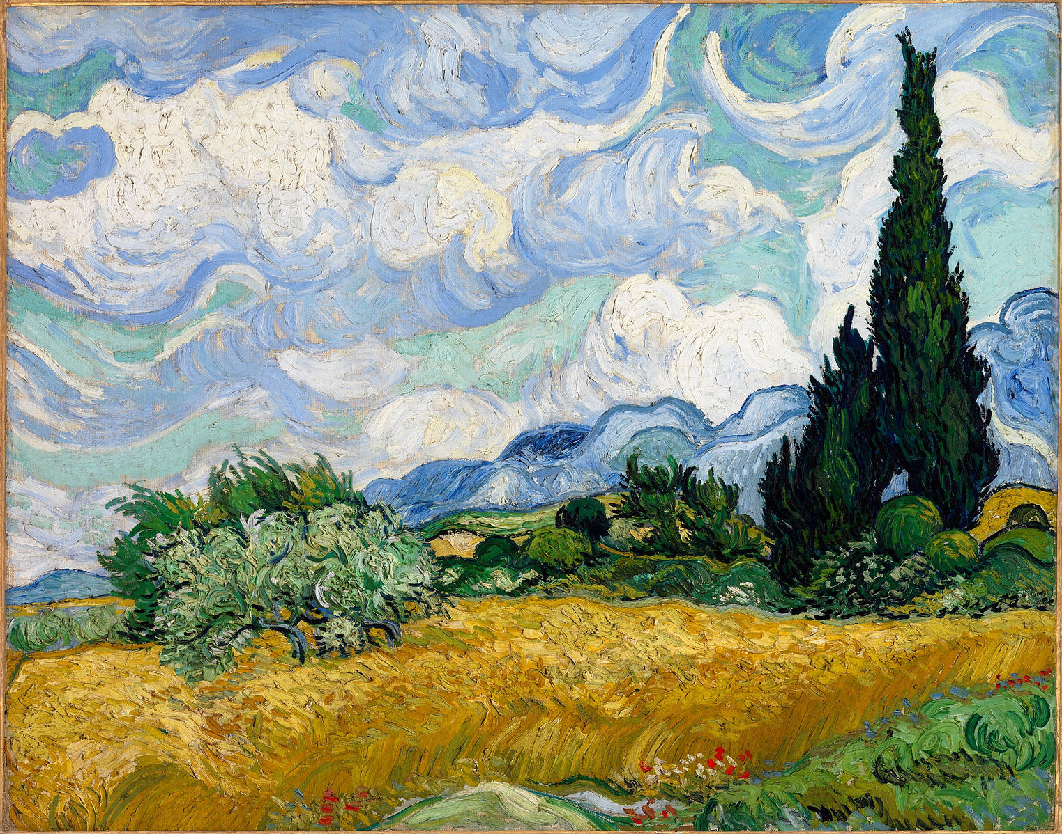
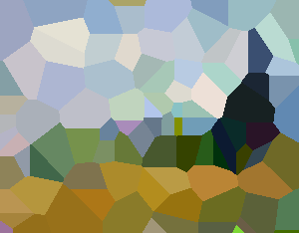
Improving Evolutionary Van Gogh
Roxana Băcălie Sanchita Ghosh Sreevidya Iyer Sofie Vos Tygo Spanhoff
Group 16

Slide 2
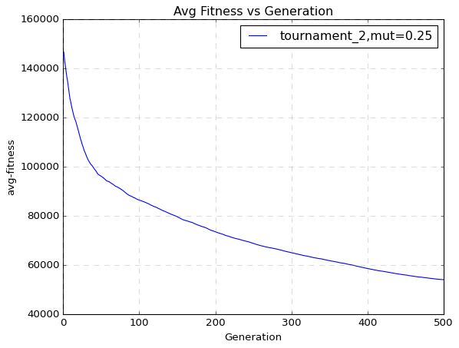
Selection Methods to improve avg-fitness
Notes:
Observation : The avg-fitness vs generation plot using the default parameters (tournament_2, mut 0.25), demonstrated a sharp decline in the first few generations then relatively plateaued.
Idea : The plateau could be made more steep and result in higher fitness after 500 generation, if there was higher selection pressure.

Slide 3
Selection Methods to improve avg-fitness
Research Question
Which selection methods and hyperparameter configuration maximizes the reduction in average population fitness over 500 generations compared to the initial method and parameters: tournament size 4 and mutation strength 0.25?

Slide 4
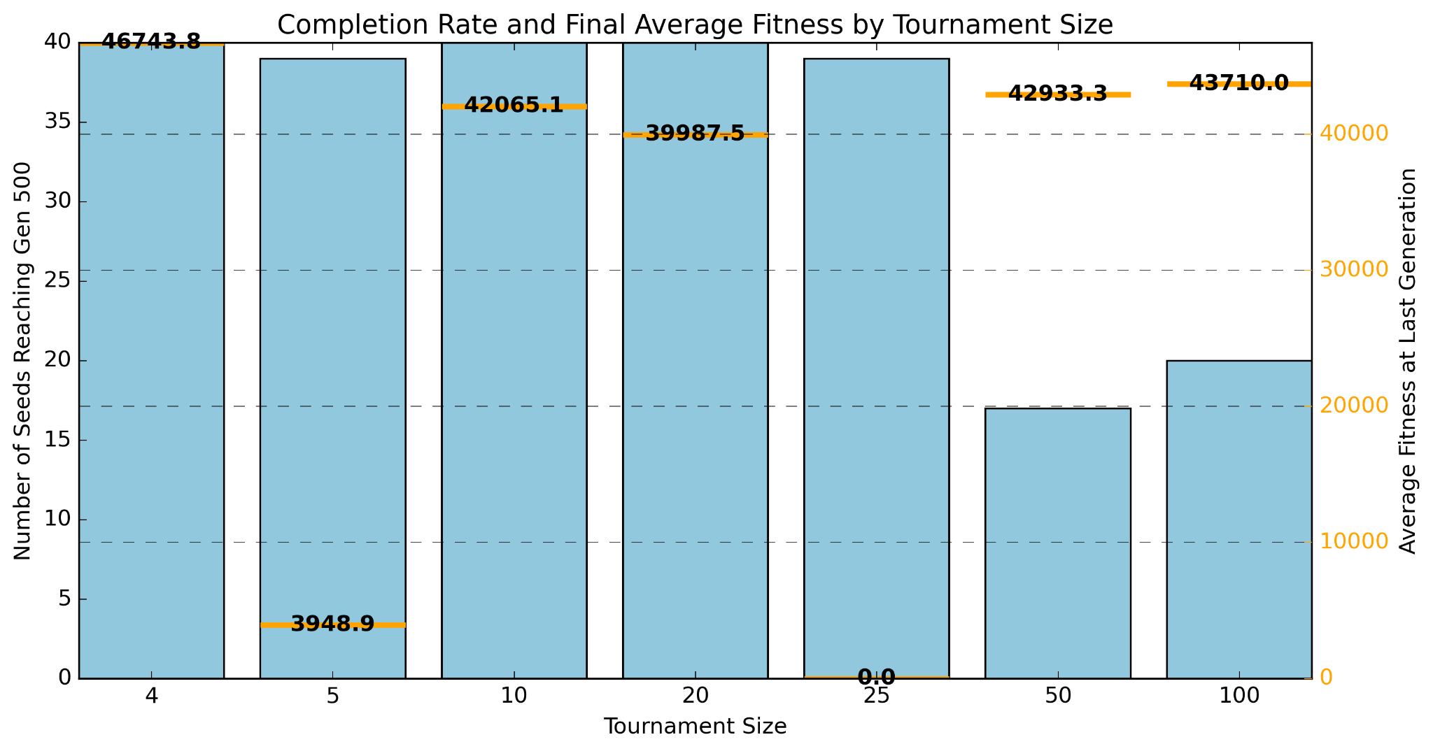
Selection Methods to improve avg-fitness : Tournament
Tournament + sus related experiments

Slide 5
Selection Methods to improve avg-fitness: Strategy
tournament size 20 -> truncation
challenge: proportionate selection -> Stochastic Uniform Sampling (SUS)
Elitism!

Slide 6
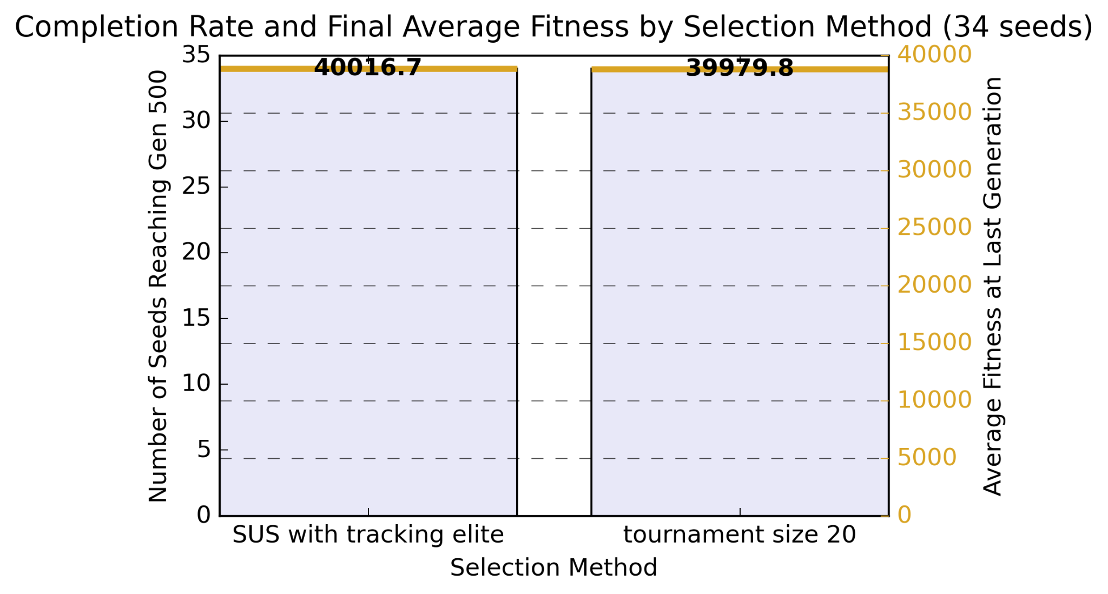
Selection Methods to improve avg-fitness :
Tournament and SUS

Slide 7
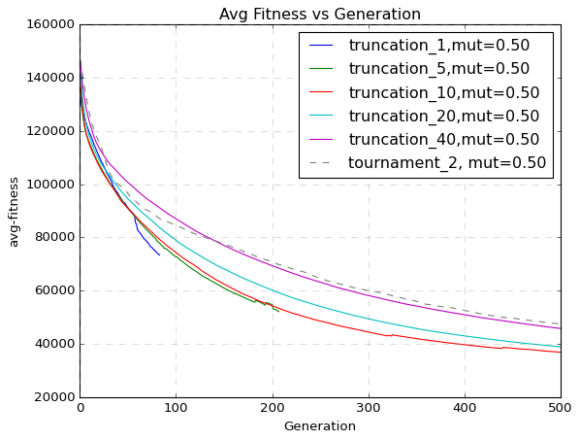
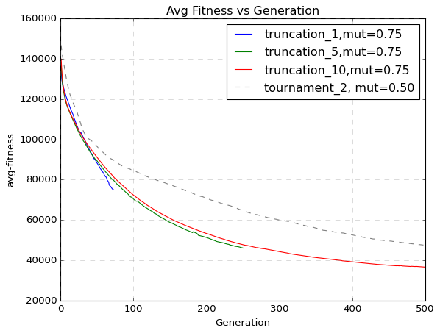
Selection Methods to improve avg-fitness : Truncation
Notes:
Initial hyperparam tuning - A fitness plateau = low exploration -> so cranked the mutation strength to 0.5, was better but not by much (55k->47k). shape of the graph still same.
Motivation for truncation - mutation alone wasnt enough to recover from stagnation (mut=0.5, still 55k). Under the original tournament-2 scheme, small fitness improvements by higher mutation were effectively lost. By increasing selection pressure (e.g. tournament-5 or truncation), we bias reproduction towards these rare better-offspring, turning exploratory mutations into lasting gains and pushing the population off the plateau.
Next step : find trunc-operator with higher pressure than initial tournament while keeping the higher mutatio strength of 0.5 Observations :
steeper avg-fitness descent in later generations,
but 1-5% truncation might be too high pressure and hence converging fast.
original tournament-2 setup is outclassed once we boost mutation and use any level of truncation other than 60%
Next Idea: Maybe we can avoid the pitfalls of early convergence for 1%, while keeping the benefits of high pressure if we can just maintain the diversity over generations.
—------------------
Step 1: hyper param tuning - more mutation cranck to 0.75 ?
higher mutation strength - did not stop the early convergence.
see 10% only went a bit beyond 200 gen
conclusion Not strong enough to maintain diversity. not depicted here but changing mutation probability also couldn't help us sustain diversity.

Slide 8
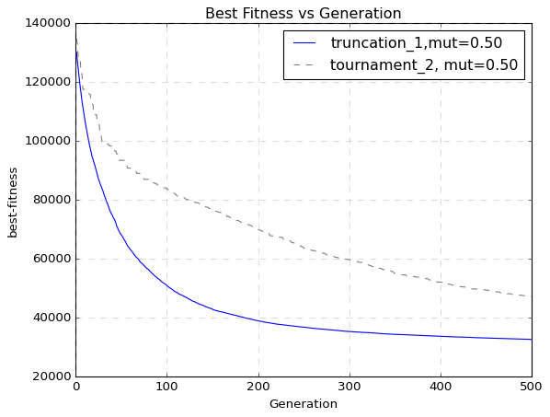
Selection Methods to improve avg-fitness : SSGA
Notes:
Did we observe these changes and overcome premature convergence ? the highest avg fitness we got here was - 32604.740833 << 47k from initial
No premature stall: Unlike before (with μ=0.25 and even 0.5), the high mutation rate keeps truncation-1 from flat-lining early—so you get both the rapid early gains of a 1% selection bottleneck and sustained improvement.
Faster descent: Even by generation 20, truncation-1 (blue) has driven the average fitness well below what tournament-2 (dashed grey) achieves, and it never looks back.
Steeper descent: Truncation-1 (μ = 0.5) settles around ~32 000 best-fitness by Gen 500, whereas tournament-2 (μ = 0.5) near ~47 000—showing that the extreme bottleneck + high mutation reaches a deeper optimum.
—-----------
In short: pairing very strong selection (top 1%) with a higher mutation strength (σ=0.5) far outperforms the milder tournament-2 scheme at the same mutation level.

Slide 9
Preserving Voronoi-points during Variation
A single Voronoi diagram is represented as:
xyrgbxyrgbxyrgbxyrgbxyrgbxyrgb
What would a good schema look like?
How about: ⋆⋆⋆⋆⋆xy⋆⋆⋆⋆⋆⋆⋆⋆⋆⋆⋆⋆⋆⋆⋆⋆⋆⋆⋆⋆⋆⋆?
And what about: ⋆⋆⋆⋆⋆xyrgb⋆⋆⋆⋆⋆⋆⋆⋆⋆⋆⋆⋆⋆⋆⋆⋆⋆⋆⋆?
Or: ⋆⋆⋆⋆⋆xyrgbxyrgb⋆⋆⋆⋆⋆xyrgb⋆⋆⋆⋆⋆?

Slide 10
Preserving Voronoi-points during Variation
How does preserving the (x, y, r, g, b)-structure of individual Voronoi points during crossover affect the algorithm’s convergence rate?

Slide 11
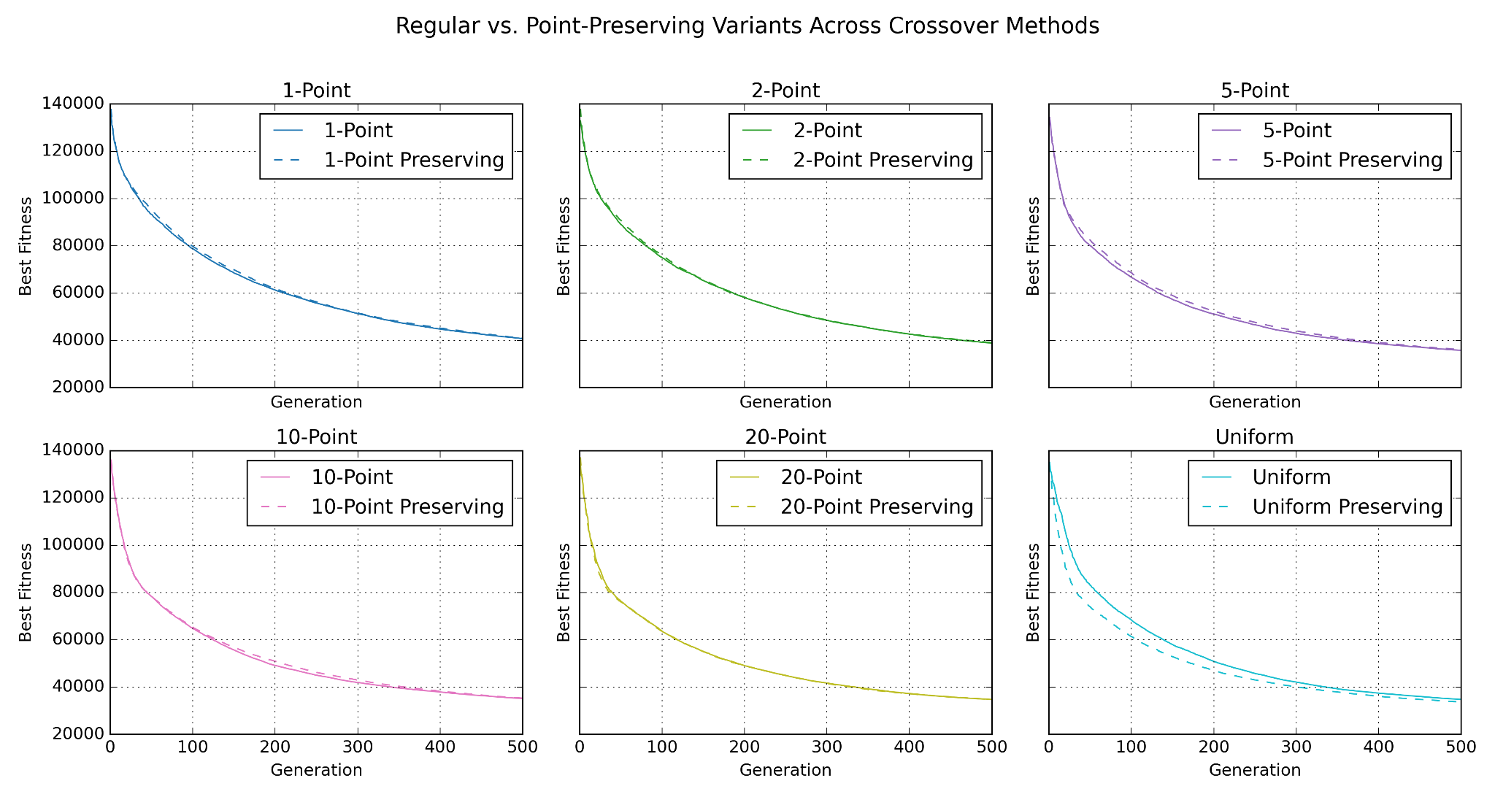
Preserving Voronoi-points during Variation

Slide 12
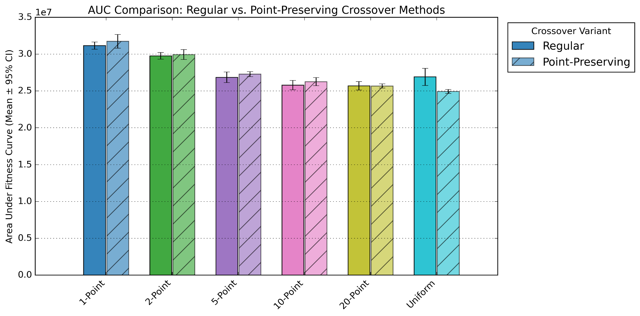
Preserving Voronoi-points during Variation: Results

Slide 13
Grey-box Initialization - Why?
Problem: Slow Convergence in Evolutionary Models
The model takes a long time to converge
It tries many random colors and positions.
Final fitness after generations varies depending on the initial population.
Results are inconsistent and unpredictable across runs.
We suspect that better initialization could improve convergence and stability.

Slide 14
Grey-box Initialization - Using Domain Knowledge
Research question: To what extent does initializing the population using points extracted from reference image improve convergence speed and solution quality compared to random initialization?
Experiments:
Edge-Based Initialization: Places more points in regions with high color variation (edges)
Region-Based Color Averaging: Starts with average colors in local regions

Slide 15
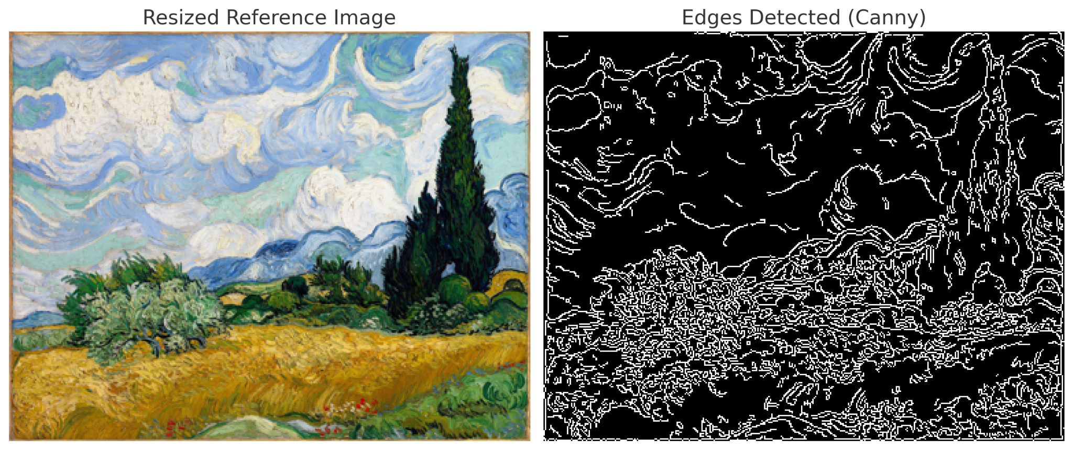
Experiment - 1 Edge Based Initialization
Notes:
Hypothesis 1: (Edge-based initialization):
Edges contain more visual structure (higher colour gradients).
Initializing with random edge points should give a better fitness score as we approximate the structure of the image from the beginning.
Set up :
Vary the percentages of points chosen from reference image and through random initialization.
Plot the differences in convergence via fitness improvement rate.

Slide 16
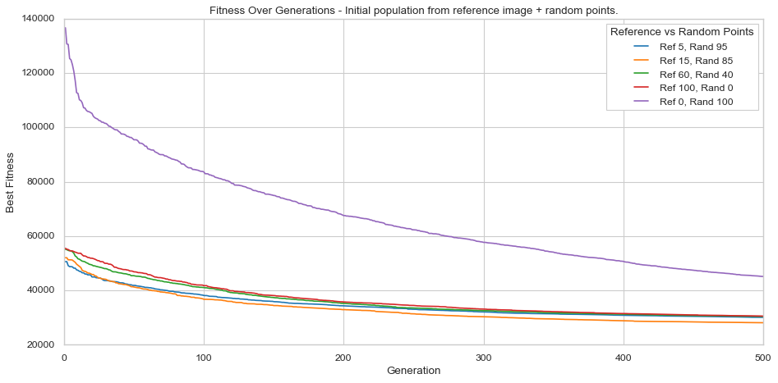
Edge-based initialization: Results

Slide 17
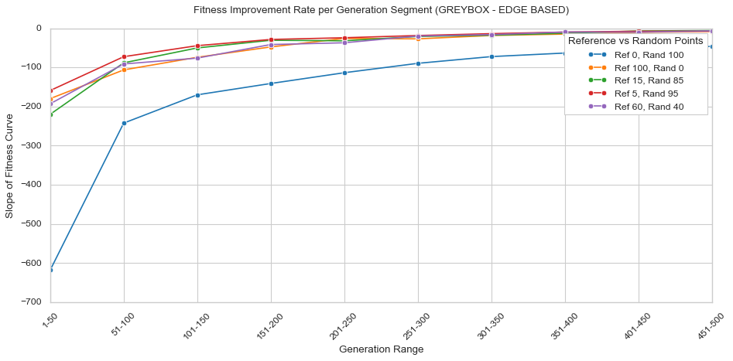
Edge-based initialization: Results

Slide 18

Experiment 2: regions-based
Captures the image’s overall tone

Slide 19
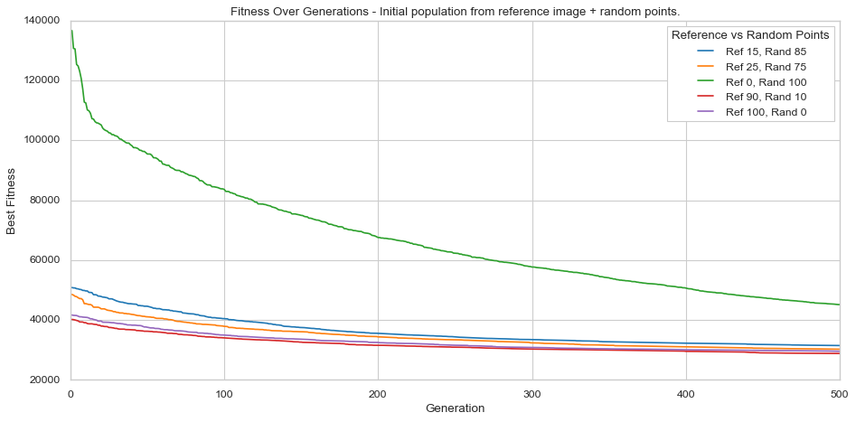
Region-based initialization: Results

Slide 20
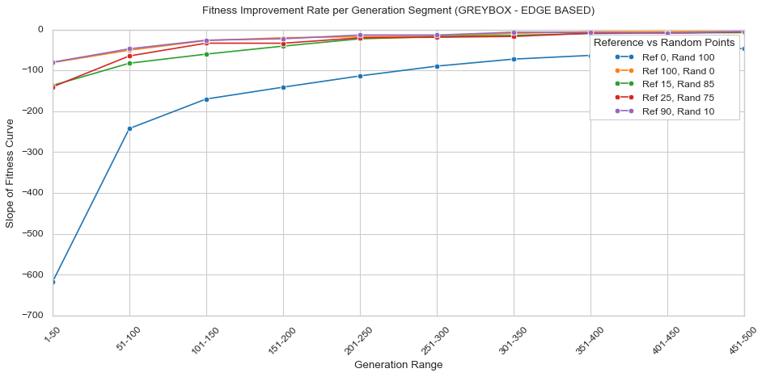
Region-based initialization: Results

Slide 21
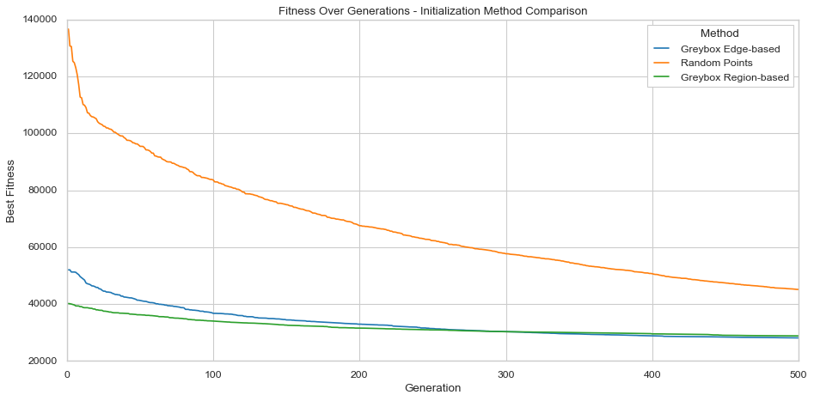
A comparison of the best fitnesses

Slide 22
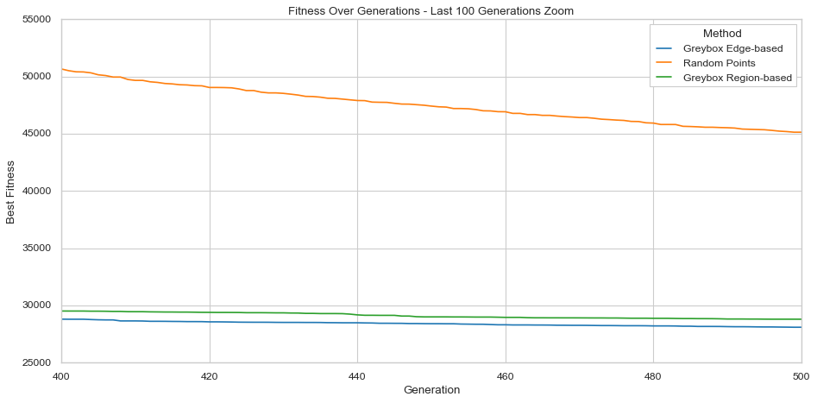
Last 100 generations

Slide 23
Questions?

Slide 24
Extra slides

Slide 25
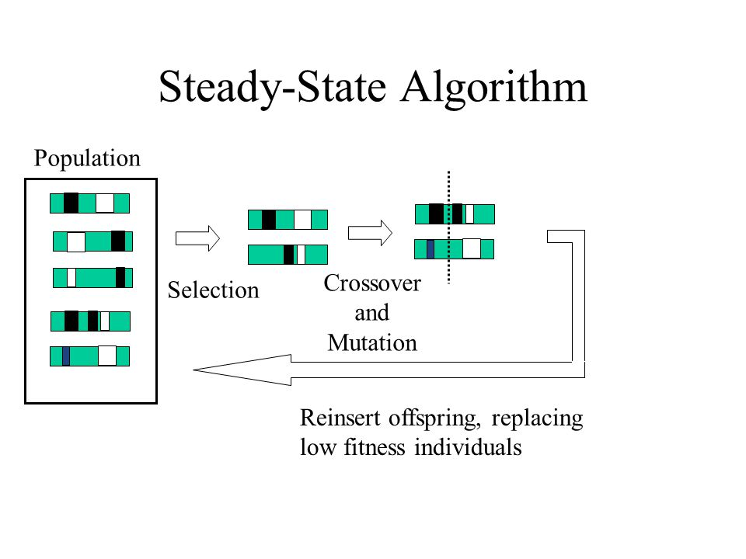
Selection Methods to improve avg-fitness : SSGA
Notes:
Step 2: operator which higher tendency to preserve diversity - ssga
Maybe mention this when asked : What is ssga ?how does it preserve diversity ?

Slide 26
Distribution of work
Roxana | Grey-box Initialization: Region-based
Sanchita | Selection-truncation + SSGA
Sreevidya | Grey-box Initialization: Edge-based
Sofie | Selection-tournament + SUS
Tygo | Voronoi-preserving Crossover

Slide 27
Preserving Voronoi-points during Variation: Goal
Goal of variation: We want to combine good schema (building blocks) of well-performing parents to get even better offspring
Schema growth equation: Schema’s with an above average fitness are expected to appear more often in the population when their probability of being disrupted is sufficiently low
Thus: Reducing the probability of disruption will encourage schemata with above average fitness

Slide 28
Preserving Voronoi-points during Variation: Idea
What does a building block in a Voronoi diagram look like? Probably: a point or set of points that captures the image well
Because: A good schema is unlikely to contain only a part of a point, because the values (x, y, r, g, b) are dependent: it makes little sense for an “xy”-value to be good on its own. Instead: “Color rgb at xy is good” makes more sense
So: Keeping individual Voronoi points intact during crossover will reduce the probability of disruption
Let’s design crossover operators that work on individual points rather than individual integers

Slide 29
Preserving Voronoi-points during Variation: Experiment
RQ: How does preserving the (x, y, r, g, b)-structure of individual Voronoi points during crossover affect the algorithm’s convergence rate?
To find out, we take several common crossover-operators and implement a version that works on integers and one version that works on points
Then, we measure the best fitness over generations per operator, and we compare the point-based operators to their integer-based counterparts

Slide 30
Preserving Voronoi-points during Variation: Results

Slide 31
Preserving Voronoi-points during Variation: Results

Slide 32
Preserving Voronoi-points during Variation: Conclusion
Point-preserving crossover does not improve n-point crossover for n<=20
Point-preserving uniform crossover seems to perform the best
Possible reasons:
n-point crossover already does not disrupt blocks that much (for low n)
point-preserving crossover might not introduce enough variation

Slide 33
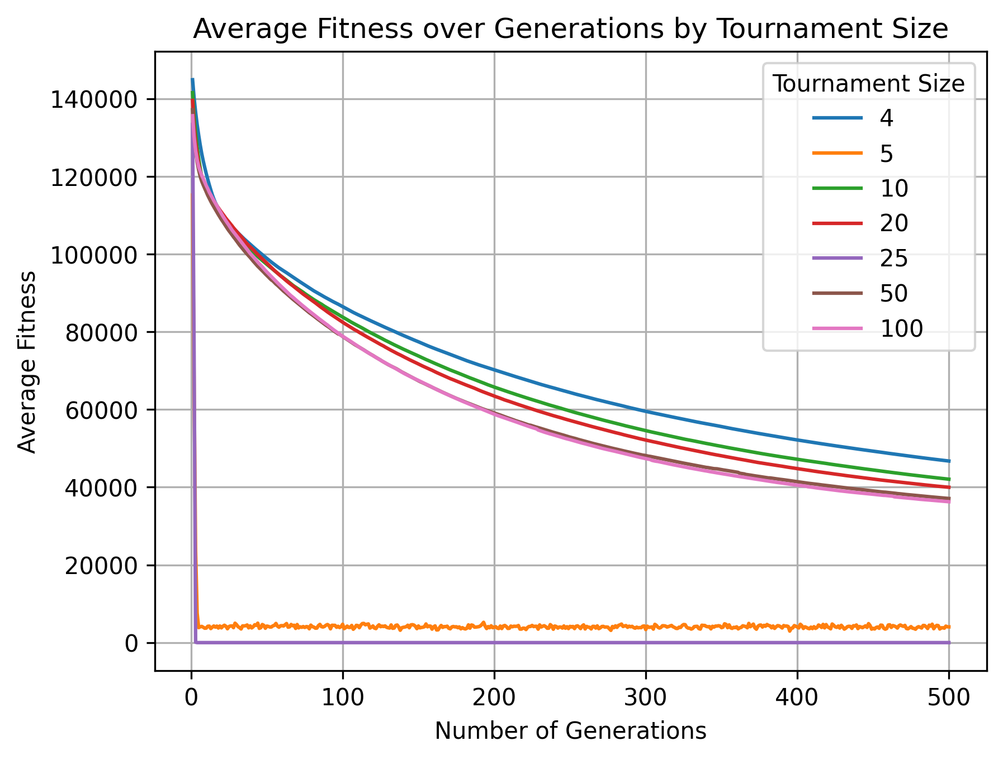
Tournament sizes

